Slide 1
HEALTH MONITORING SYSTEM USING ESP8266

Slide 2
ABSTRACT
Nowadays Health-care Environment has developed science and knowledge based on Wireless-Sensing node Technolgy.
Patients are facing a problematic situation due to heart problems and attack which is because of nonexistence of good medical maintenance to patients at the needed time.
By using Patient Health Monitoring that uses sensor technology and internet to communicate to the loved ones in case of problems.

Slide 3
CONTENTS
Introduction
Requirements
Components
Block diagram
Connections
Working
Advantages/disadvantages
Conclusion
Future Scope

Slide 4
REQUIREMENTS a)Hardware
PIC18F46K22 microcontroller
• Liquid crystal display(LCD)16x2
• GSM modem
• Wi-Fi module (ESP8266)
•Temperature sensor (DS18S20)
• Pulse oximeter sensor
• MAX232
•Piezo electric buzzer

Slide 5
b) Software
• Embedded C Programming
• MPLAB IDE v8. 92
• Proteus 7.0 ISIS Professional
• DIPTRACE
• Hi-Tech-C Compiler
• Hyper text mark-up language

Slide 6
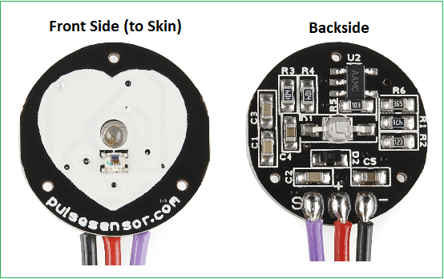
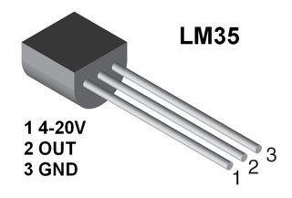
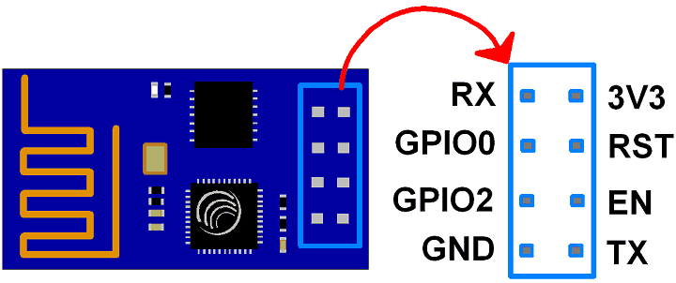
Components
Pulse sensor Temperature Sensor
ESP8266

Slide 7
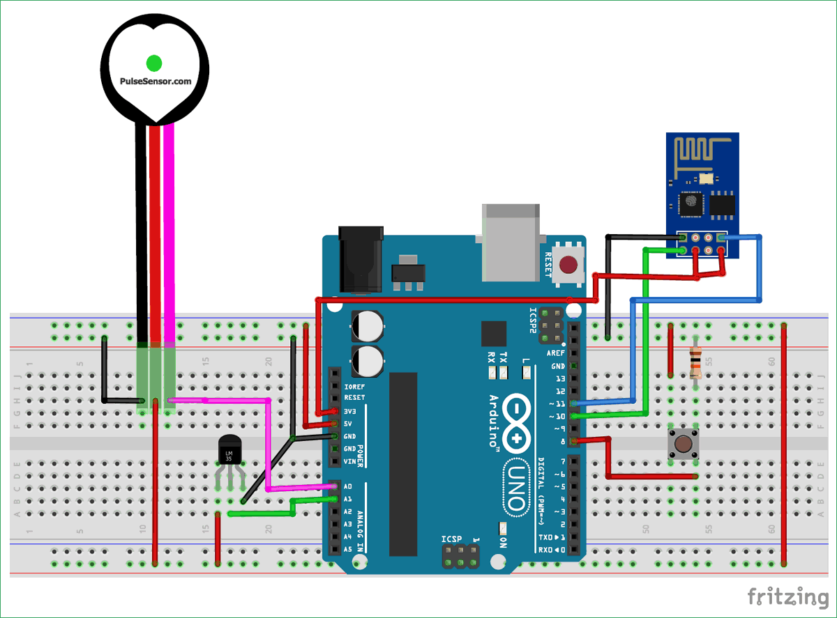
BLOCK DIAGRAM

Slide 8
Connections
Signal pin of pulse sensor -> A0 of arduino
Vcc pin of pulse sensor -> 5V of arduino
GND pin of pulse sensor -> GND of arduino
Vout of LM35 -> A1 of Arduino
Tx of ESP8266 -> pin 10 of arduino
Rx of ESP8266 -> pin 11 of arduino
CH_PD and Vcc of ESP8266 -> 3.3 V of arduino
GND of ESP8266 -> GND of arduino
Push button -> digital pin 8 of arduino

Slide 9
WORKING
Connect Pulse Sensor output pin to A0 of Arduino and other two pins to VCC & GND.
Connect LM35 Temperature Sensor output pin to A1 of Arduino and other two pins to VCC & GND.
Connect the LED to Digital Pin 7 of Arduino via a 220-ohm resistor.
Connect Pin 1,3,5,16 of LCD to GND.
Connect Pin 2,15 of LCD to VCC.

Slide 10
Conti..
Connect Pin 4,6,11,12,13,14 of LCD to Digital Pin12,11,5,4,3,2 of Arduino.
The RX pin of ESP8266 works on 3.3V and it will not communicate with the Arduino when we will connect it directly to the Arduino. So, we will have to make a voltage divider for it which will convert the 5V into 3.3V. This can be done by connecting the 2.2K & 1K resistor. Thus the RX pin of the ESP8266 is connected to pin 10 of Arduino through the resistors.
Connect the TX pin of the ESP8266 to pin 9 of the Arduino.

Slide 11
ADVANTAGES
Associating the gap between the patients and the doctor
Best to be used in rural areas for multipurpose. So that all the conditions are simply measured
Operation of this device is very simple
It gives a good performance when we compare it with a compact sensor.

Slide 12
DISADVANTAGES
Bitter Expensive.
Interference of little noise in GSM modem due to high Radio frequency signals.

Slide 13
CONCLUSION
The importance of sensor data for capturing early signs of health decline
Time In-home embedded health assessment system
Identifying health decline early provides a window of opportunity for early treatment that can address health problems before they catastrophic
Reduced health care cost,continued independence and quality of life.

Slide 14
FUTURE SCOPE
Furthermore, this project can be enhanced by using different parameters such as retinal size, BP, weight, and age can be included to control the parameters in the future. And also this system can be developed by using advanced technologies like GPS and GSM

Slide 15
It is portable, simple to use and prevention is better than cure.
THANK YOU

